Slide 1

Dengue Control System
Waqas Ahmed
Awais Manzoor Bajwa

Slide 2
Problems
Large number of patients are suffering from dengue.
No system to manage this Disease
Resources are not being used efficiently
Dengue is not so deadly but still large amount of patients dies
Large amount of dengue patients admitted to hospitals. Not managed properly
Patient Doctor Communication
Awareness
Many people unable to go to the Hospital

Slide 3
Solution
An online system managing patients
Patients don’t have to get admitted to hospital
Doctor will manage only serious patients
Patients and doctors can review their history
Patients automatically gets alarm according to prescriptions and Doctor or patient can send notification to each other

Slide 4
Patient will be able to send his image
Patient will be able to send Blood pressure, Glucose level, weight, temperature etc. by using digital devices
Patient will fill the form of required tests which don’t have digital devices available
Awareness messages sent to all patients

Slide 5
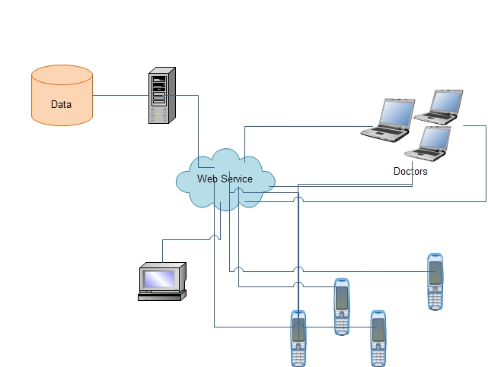
Architecture

Slide 6
Existing Solutions
Currently in Pakistan there is no such solution available to Control Dengue
Later this application will evolve to handle all kinds of patients
Applications exist for managing patients but not on mobile platform.

